Slide 1

EXCEL FINAL ASSESSMENT
PREETHI L
EMP ID: 4296

Slide 2
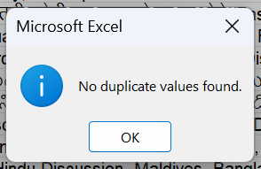

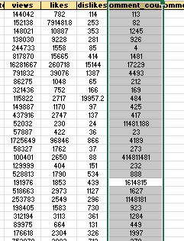
Question 1-Data Cleaning
INSIGHTS
** Have given with YouTube dataset which is about trending videos. Clean the dataset using functions without any null values.
STEPS:
1.Firstly I have checked whether there are any duplicates using remove duplicates function
2.And found the null values and replaced it with the mean value.
3.Used Find and Replace (Ctrl+H) for the replacements.
4. And attached the screenshot for the proof of removing the null values and replacing it.

Slide 3
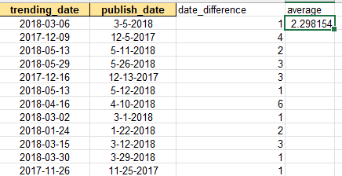
Question 2-Time analysis
INSIGHTS
Have to find the difference between the video published date and trending date.
STEPS:
1.I have taken the publish_date and trending_date column separately and found the the difference between two using DATEDIF function
2.And find the average time gap for a video to trend is minimum of 3 days.
DATEDIF(B2,A2,"D")
AVERAGE(C2:C16308)

Slide 4
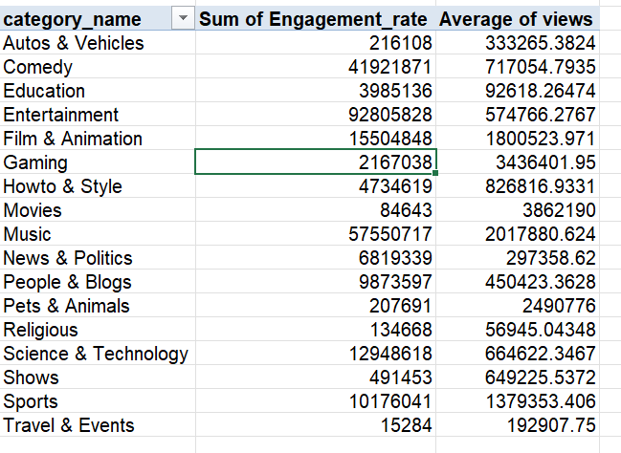
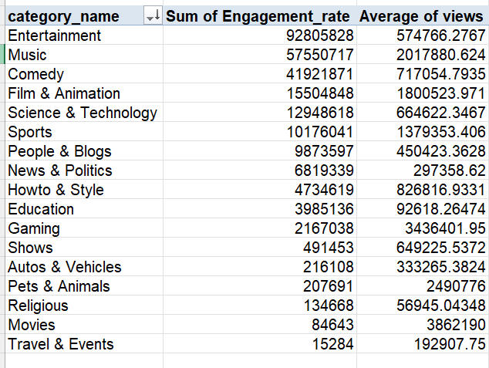
Question 3-Category Analysis
INSIGHTS
Have to calculate the categories which has the best in terms of views and engagement
Steps
1.Calculated the average number of views per category using PIVOT TABLE
2.And found engagement rate Using(like +comments)
3.And found the category for each vidos using Xlookup based on category_id XLOOKUP(E2,Category!$A$2:$A$33,Category!$B$2:$B$33)
4.Found that Entertainment has the highest average views and engagement_rate

Slide 5
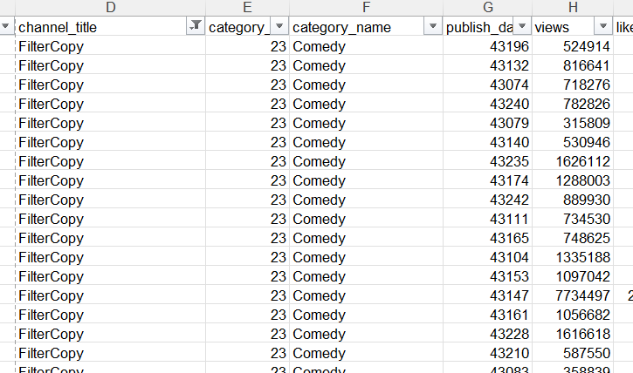
Question 4-Filter and Xlookup
INSIGHTS
Have to filter the dataset and lookup for the category name using category_id
STEPS:
1.Used Xlookup for finding the category_name for each channel names using category_id
XLOOKUP(E2,Category!$A$2:$A$33,Category!$B$2:$B$33)
2.Filtered the channel name for “Filter copy” and category_id 23 & category_name “comedy”

Slide 6
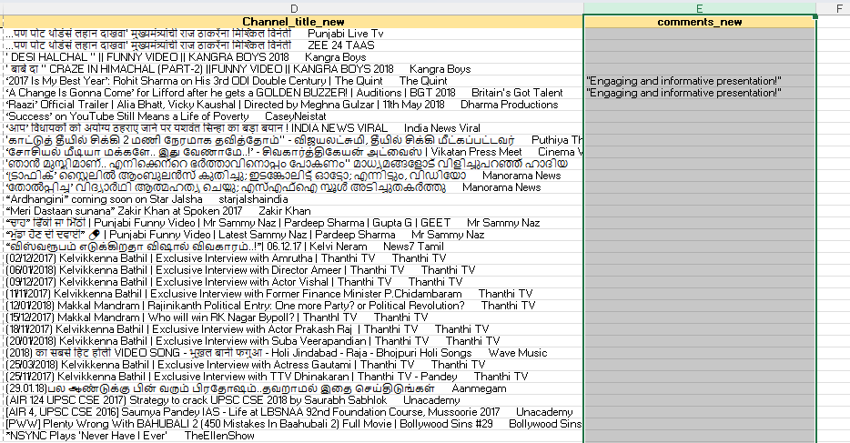
Question 5-Text Analysis
INSIGHTS
Have to concatenate the title and channel_title
And join the comments of same_videos by text join
STEPS:
1.Conactenated the values using the concat function
2.And textjoin function is used to join the comments.

Slide 7
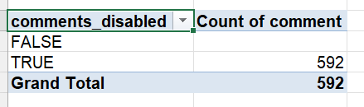
Question 6-Comment Analysis
INSIGHTS
Calculate the comments count for comments enabled vs disabled
STEPS:
1.Just grouped the value for comments enabled vs disabled(TRUE or FALSE)
2.And compared the comments using column chart
3.And for grouping pivot table is used.

Slide 8
Question 7-Visual Creation
INSIGHTS
TO create a visuals using charts and make it interactive using slicers
Steps:
1.Created a chart using pivot table
2.For sum of likes,views etc
3.And used slicers to filter the data

Slide 9
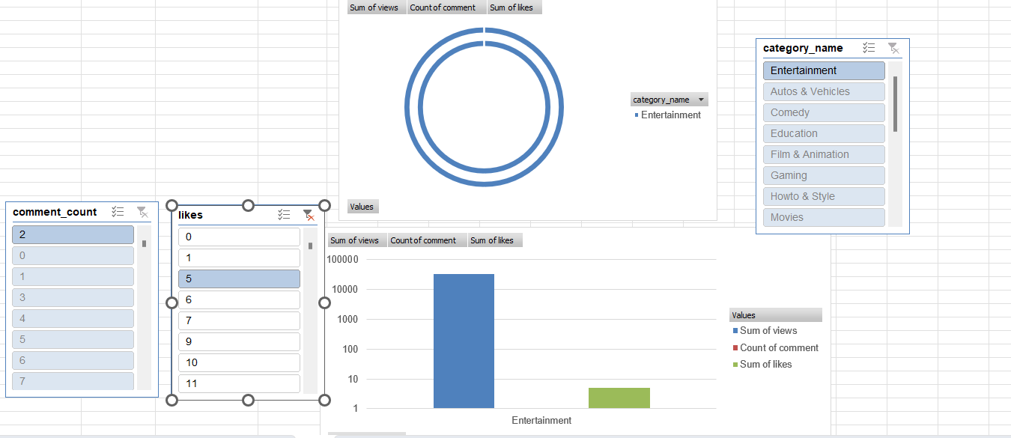
Question 7
INSIGHTS

Slide 10
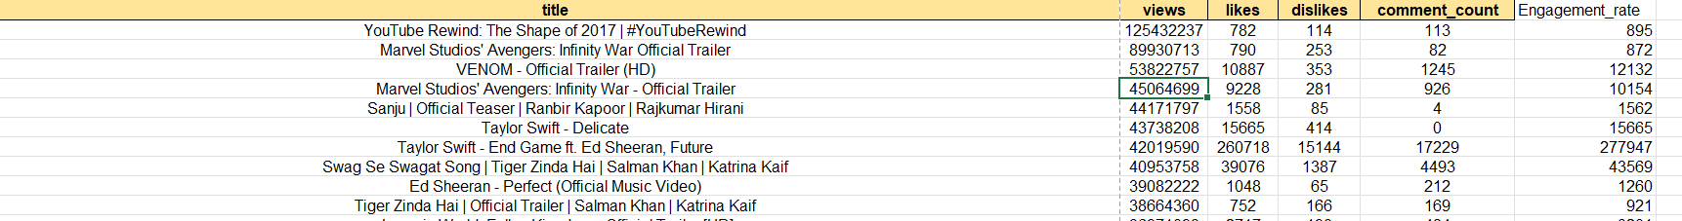
Question 8-Top 5 and Bottom 5
INSIGHTS
Here have to do top 5 and bottom 5 by uising filters
Steps:
1.Done the sorting (Descending order)
2.Find the top and bottom 5
3.Found the top 5 videos for each category

Slide 11
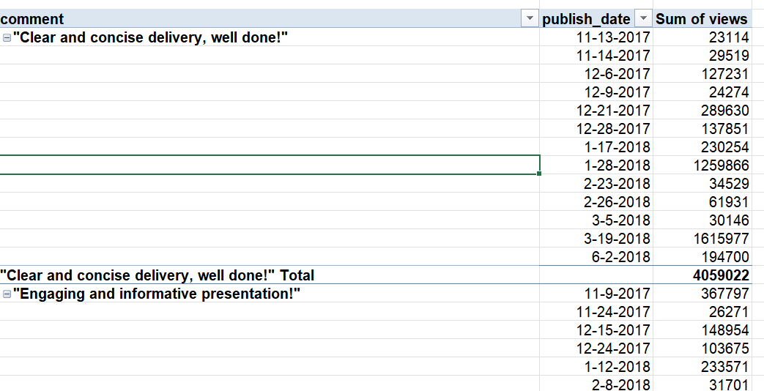
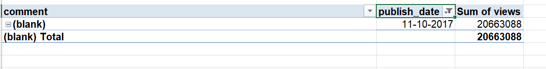
Question 9-filter by conditions
INSIGHTS
Analyzed that the comments with publish _date and views
And published for a date
11-10-2017

Slide 12
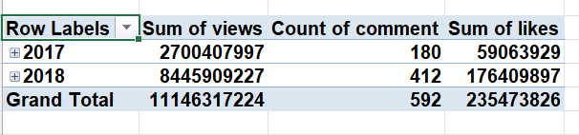
Question 10
INSIGHTS
Here I have compared the views of videos using published_date using pivot table

Slide 13
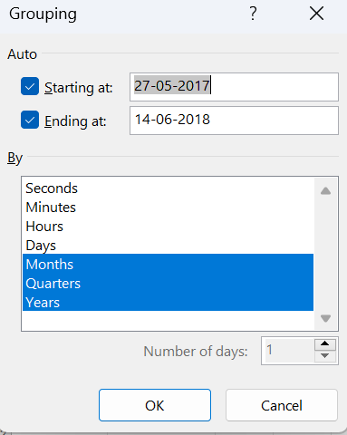
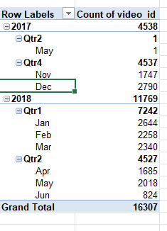
Question 11
INSIGHTS
Grouped the videos count based on publish date

Slide 14
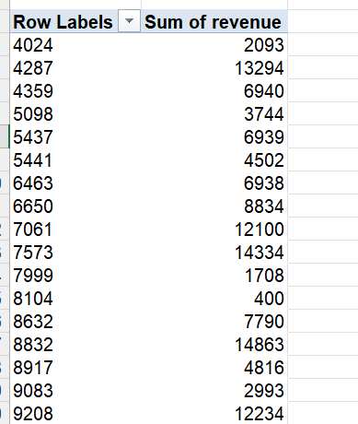
Question 12
INSIGHTS
Have to find the revenue rate based on views
Found the total revenue for each video using pivot table

Slide 15
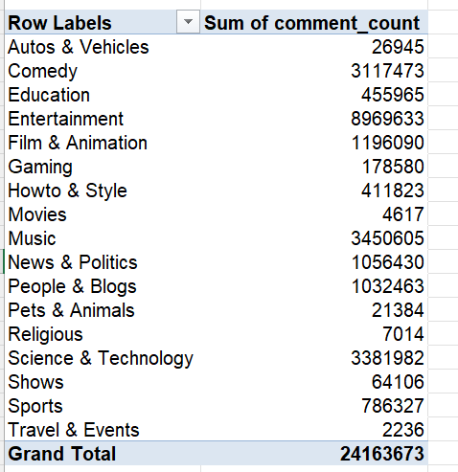
Question 13
INSIGHTS
Checked the comment_count with each category

Slide 16
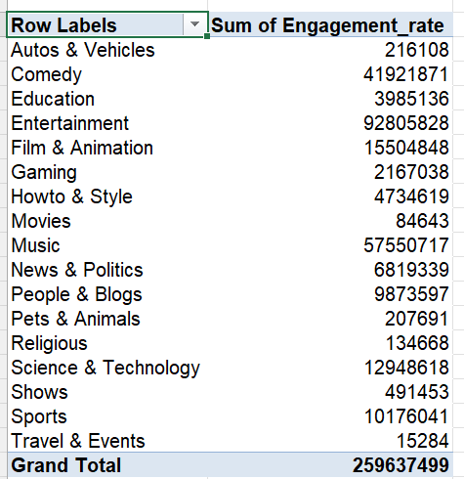
Question 14
INSIGHTS
Here,I have been created the plots to compare the category with engagement_rate

Slide 17
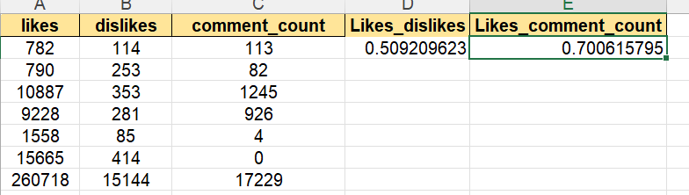
Question 15
INSIGHTS
Here I have calculated the correlation coefficients for likes ,dislikes,comment_count.
For likes and dislikes
CORREL(A2:A16308,B2:B16308)
For likes and comment_count
CORREL(B2:B16308,C2:C16308)

Slide 18
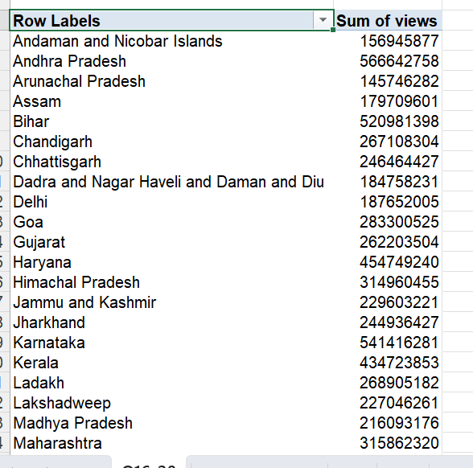
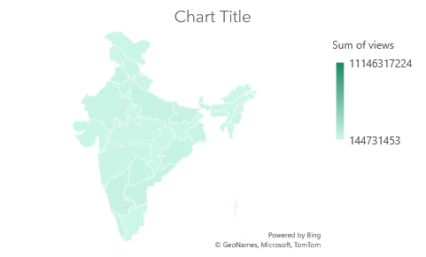
Question 16
INSIGHTS
Sum of views based on the different countries

Slide 19

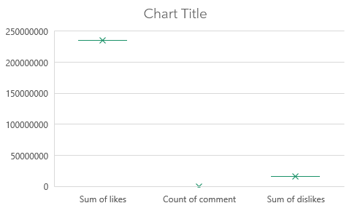
Question 17
INSIGHTS
Done histogram chart for likes and comments and dislikes

Slide 20
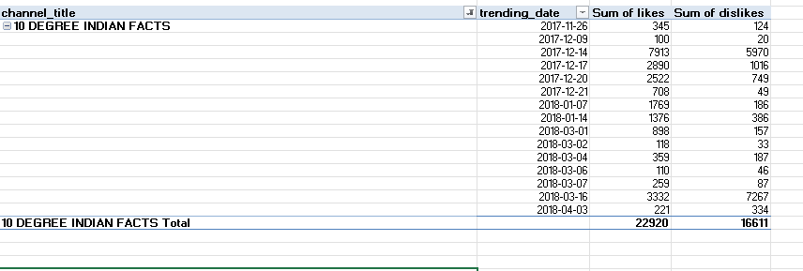
Question 18
INSIGHTS
Done for 10 degree facts channel

Slide 21
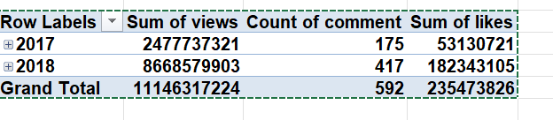
Question 19
INSIGHTS
Done using line charts (100%stacked line chart)

Slide 22
Question16-20

